Slide 1


Company X and Unify presents
UC and Mobility platform
Hosted or at your own location
Notes:
Front page:
Text 3 - Where is the value of smaller companies with a telecommunications / communications system?
Text 4 - Is a telecommunications / communications system important?
Text 5 - What is a telecommunications / communication system?
(Read, understand and communicate these messages continuously through the presentation).
You must change "Company X" to your own company name.
There is no background to the following slides, it can even be included with your company logo.
If you want other graphic files fell free to use your own
On page 22 to 23 there is some product options
Options on page 22 can only be order with Orla or Tommy

Slide 2


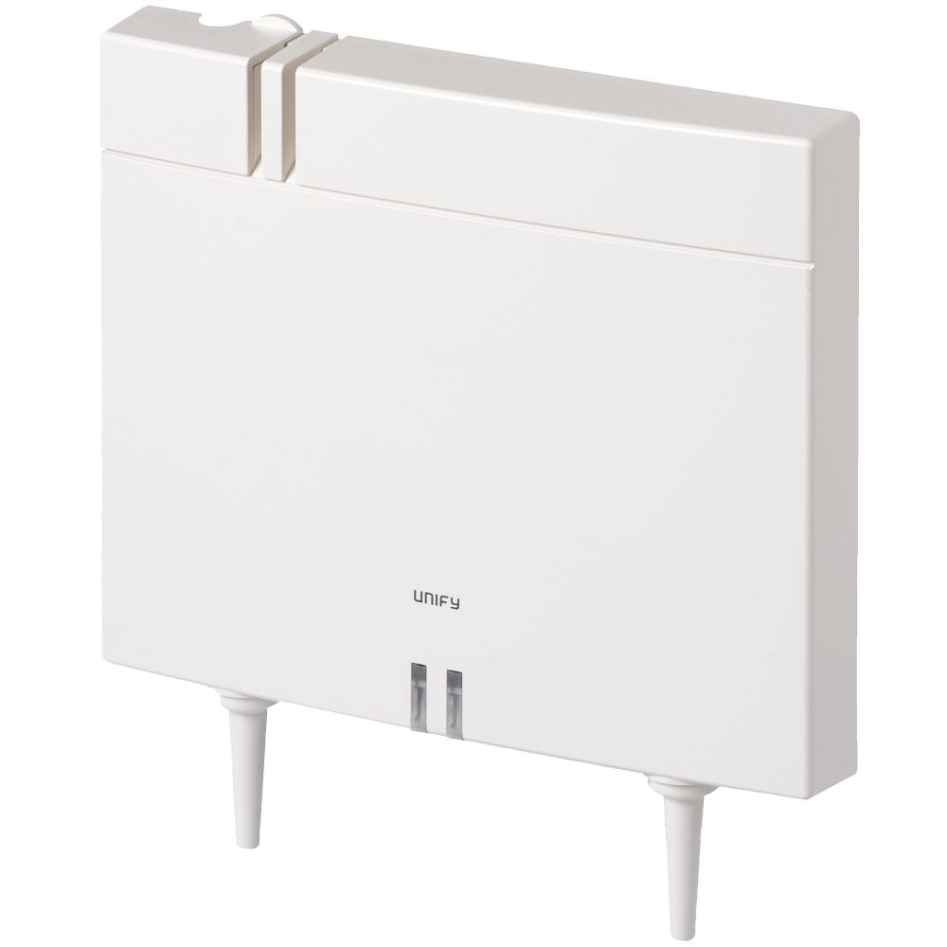
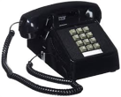


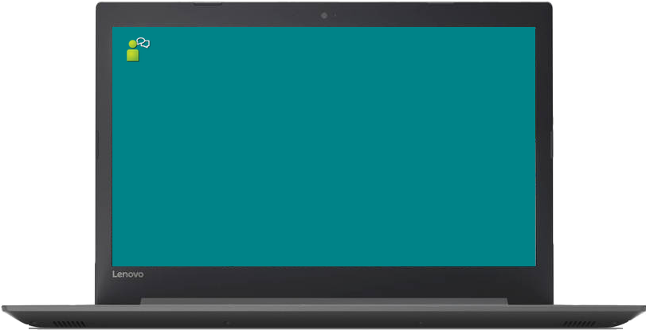
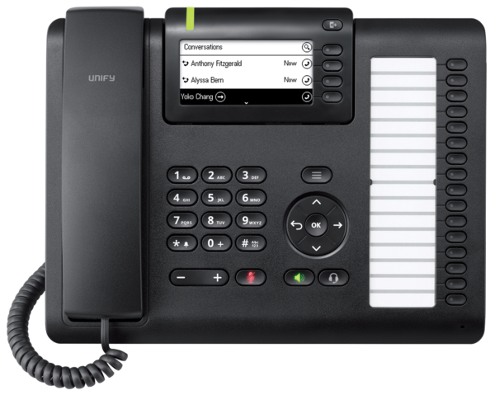
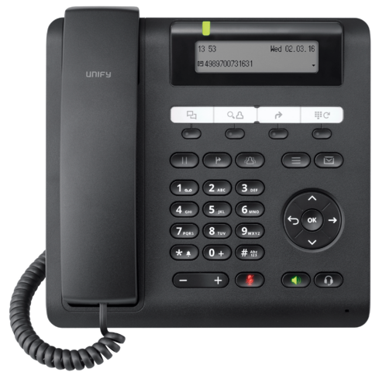
Solution today
Solution tomorrow
Mandatory
Options
Included
4G + LTE
WiFi
PSTN Provider
ITSP
Internet
NOTE! PC, Server and mobile phone / smartphone are not included
Notes:
The page changes when clicking with the mouse, noting that PC, smartphone and server are not included.
Text 1 - What benefits does a company have with a telecommunications / communications system?

Slide 3



Software Platform
OpenScape Business S is a server-based "All-In-One" Unified Communications platform (UC) that supports up to 1500 IP subscribers and Internet Telephony Service Provider (ITSP) connection to the public network or a dedicated MPLS (WAN). It is designed for Linux (Novell SLES) operating system and can be operated either on physical or virtual machines with VMware vSphere or Microsoft Hyper-V.
For more information click on the image.
OpenScape Business S system software er inklusiv 3 års support (SSP) og en SLES 11 SP4 64-bit med 1 års opgraderingsaftale med Novell
You can use your own VMWare or Hyper V environment, even at a hosting center. The hosting center must support advanced routing in and out.
Notes:
Click on OSBiz S logo will open a browser and take you to wiki page for OpenScape Business S.
You should focus in particular on 3 years of software, support and upgrade of OSBiz S and that 1 year upgrade license for SLES is included (this must be renewed once a year)

Slide 4
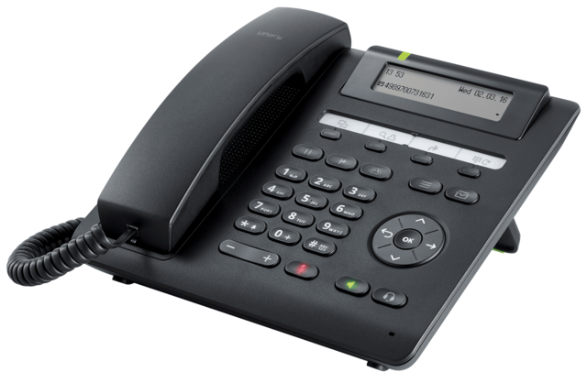
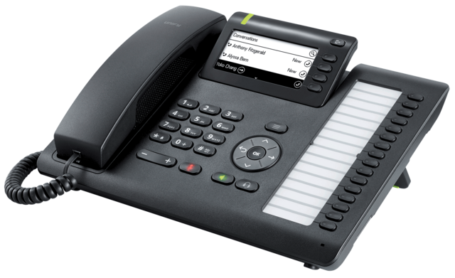
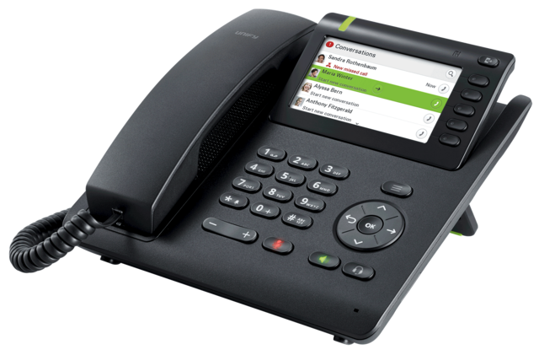
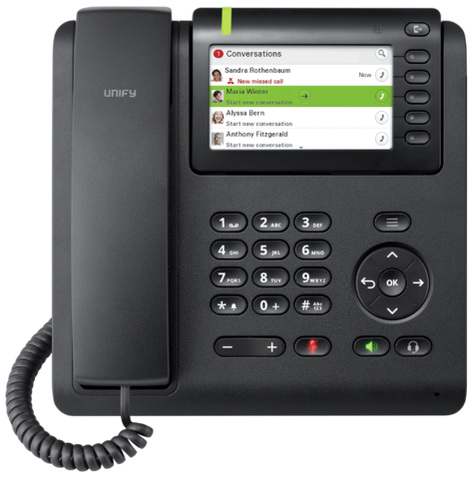
OpenScape Desk Phone CP
By clicking on the image you can read more about the phones
Further models to be released in 2018/2019
CP200
CP205
CP400
CP600
An OpenScape Desk Phone CP200 and a CP400 are included
Notes:
Click on the individual phones and you will get to Unique's page for each model, making it easier to explain the differences and features.
Click on the individual phones will open a browser and take you to wiki page for OpenScape Business S.
Focus on the presence status displayed on the display on the phones, and that they have won more awards and have HD sound.
Programmable buttons and more.

Slide 5



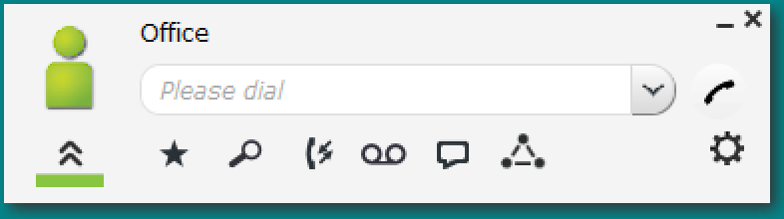
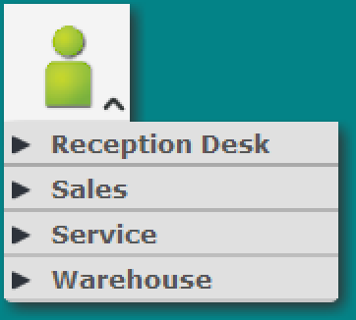


myPortal Smart is an Adobe AIR-based PC application (Microsoft Windows and Mac OS X) for unified communications using the UC solution UC Smart. Besides convenient dialing aids via phone directories and favorites and information on the presence status of colleagues, you can, for example, also access your voicemails.
Depending on the licenses assigned to you, the scope of the available features may vary slightly.
myPortal Smart supports the following features:
Presence status
Status-based call forwarding
Directories
Favorites List
Journal
Search by phone number and name
Call Functions
One Number Service (ONS)
Voicemail
Text messages
myPortal Smart
myPortal smart - Key Features
Advanced Directory (Contacts)
Call Status
Call Journal
Visual Voicemail
Presenence based voicemailVocemail to Email
Presenence
Office
Meeting
Sick
Break
Gone Out
Vacation
Lunch
Gone Home
Do Not Disturb
Status based Call Forwarding
Conferece
Schedule Conferece
Options
Web Collaboration
Instant Messaging
Desktop Dialing
Notes:
Click on the myPortal Smart icon and myPortal Smart "launches", the following slide shows an interactive image of myPortal Smart, so wait to explain.
Some of the texts are in English and you can translate it if you want, but we recommend keeping it in English (The original Unify text).

Slide 6
myPortal Smart
Settings made here will automatically be transferred to myPortal to go and the same applies to settings made in myPortal to go.
Notes:
Click on myPortal Smart and you will come to the next picture with explanation.

Slide 7
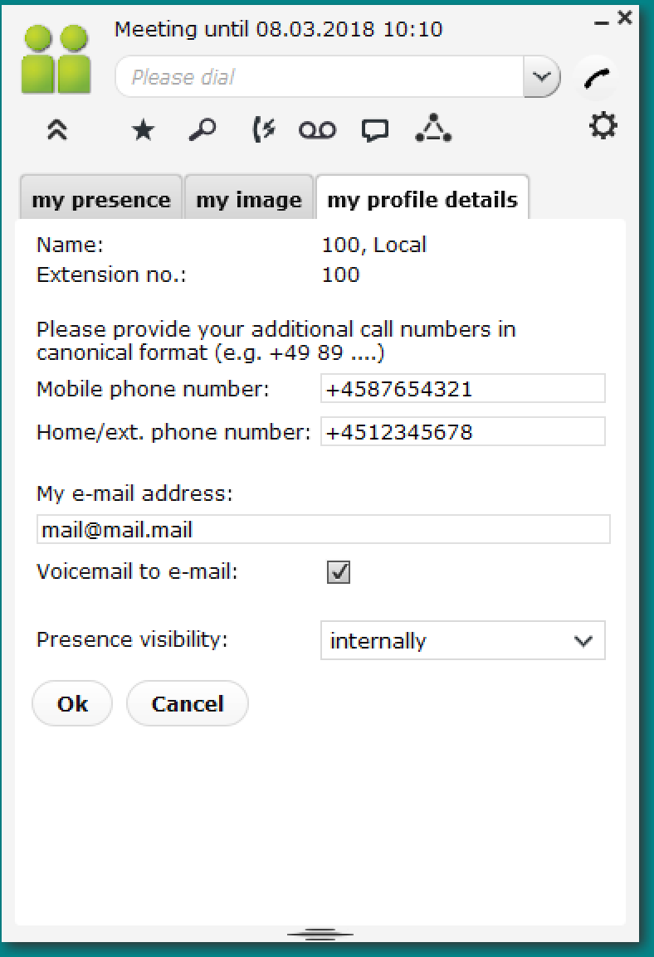
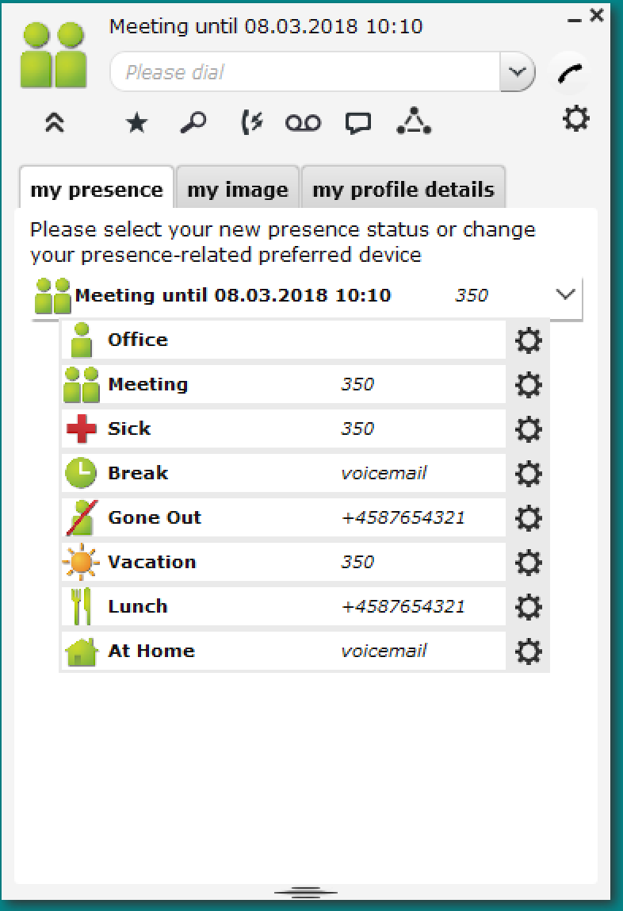
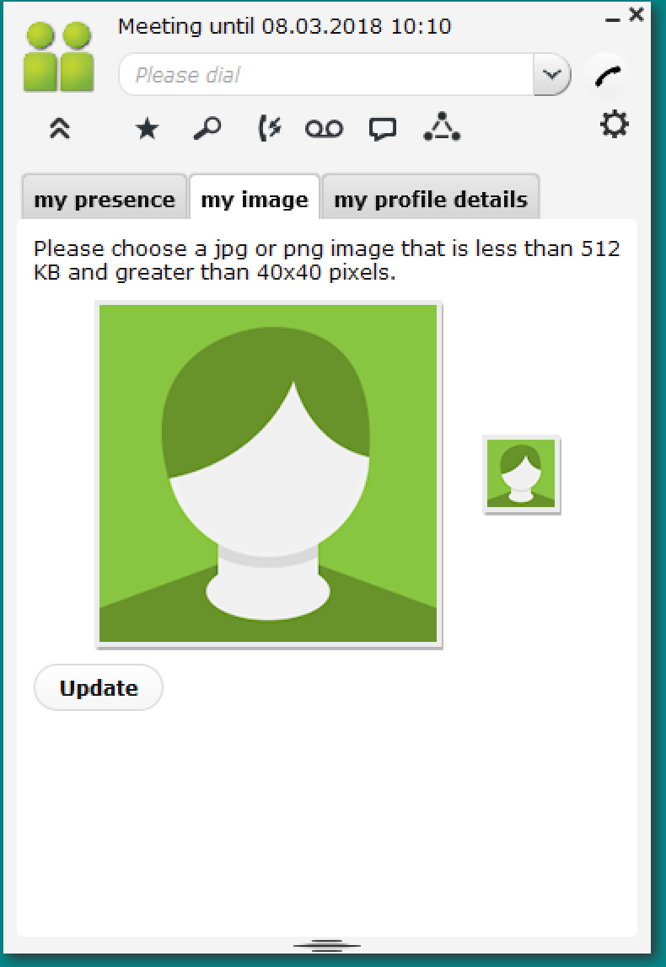
myPortal Smart
My presence
You can choose your presence and Status-based call forwarding
My image
Here you can put your picture in
My profile details
Here you enter your data, they are used, for example, in my presence
Settings made here will automatically be transferred to myPortal to go and the same applies to settings made in myPortal to go.
Notes:
Click for next picture with explanation.

Slide 8
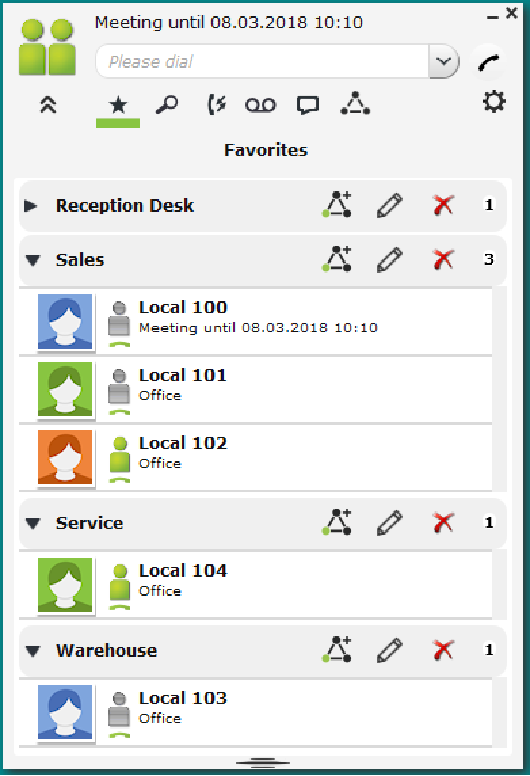
myPortal Smart
Favorites
Here, your favorites will be displayed, they will be divided into departments, with internal and external favorites.
Settings made here will automatically be transferred to myPortal to go and the same applies to settings made in myPortal to go.
Notes:
Click for next picture with explanation.

Slide 9
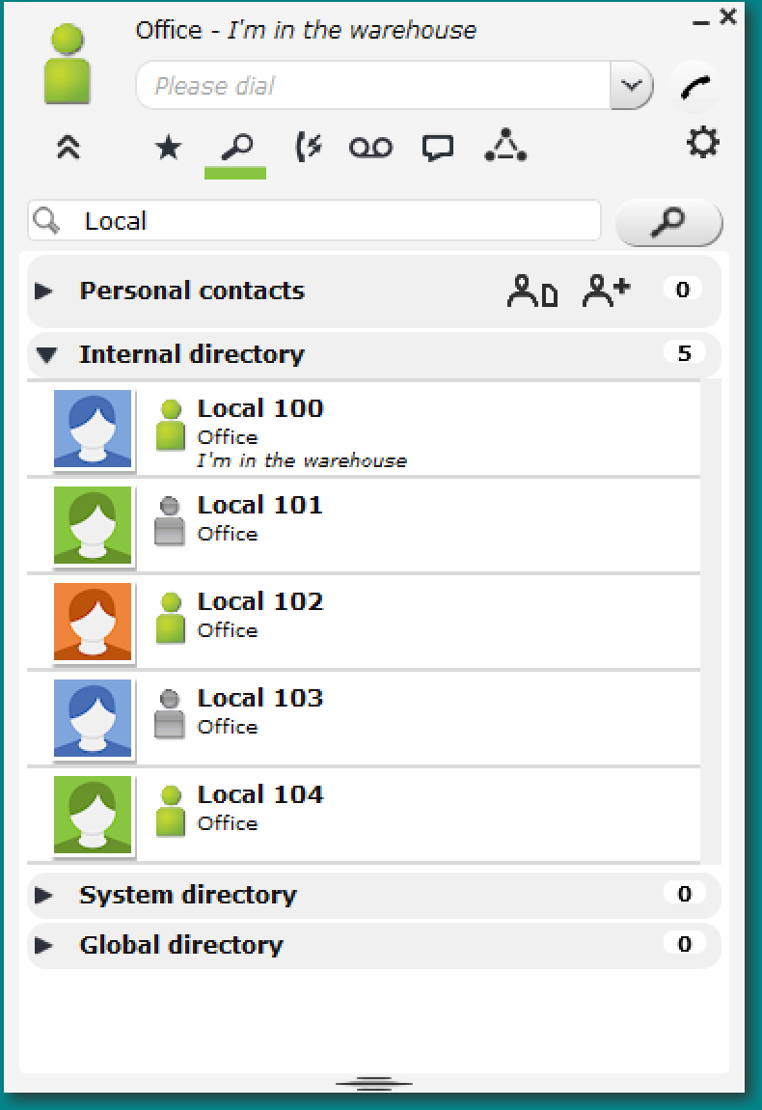
myPortal Smart
Search
Advanced Phonebook that contains:
Personal contacts
Internal directory
System directory
Global directory
Settings made here will automatically be transferred to myPortal to go and the same applies to settings made in myPortal to go.
Notes:
Click for next picture with explanation.

Slide 10
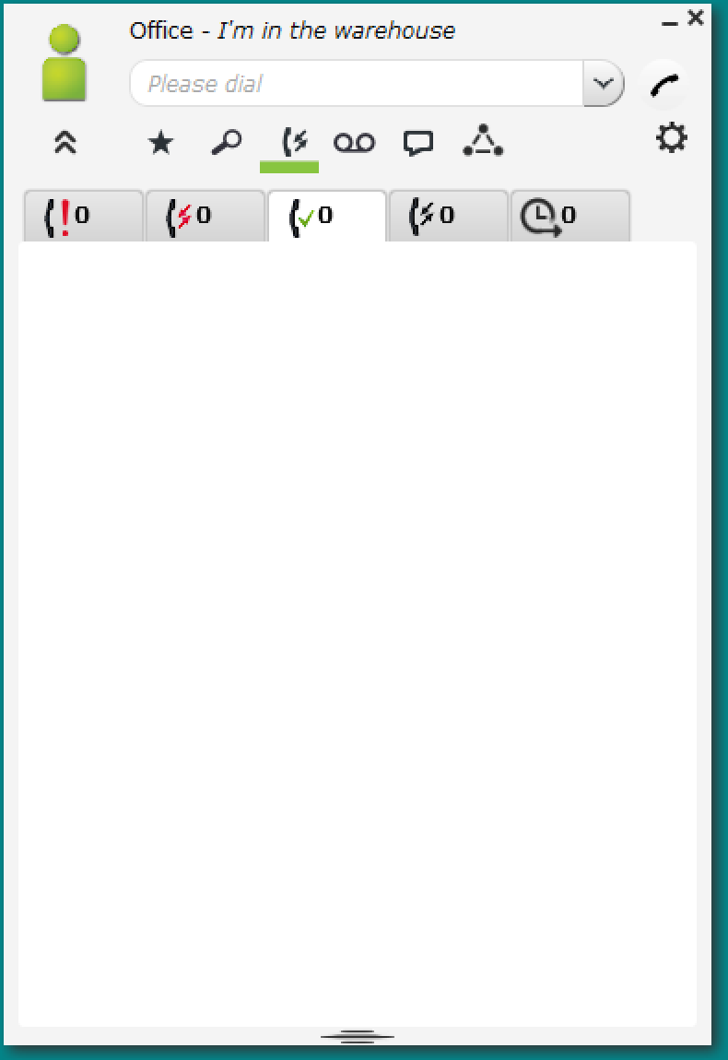
myPortal Smart
Journal
In the journal, you can view:
Calls you have made without contact
Lost calls
Answered calls
All calls
Scheduled calls
Settings made here will automatically be transferred to myPortal to go and the same applies to settings made in myPortal to go.
Notes:
Click for next picture with explanation.

Slide 11
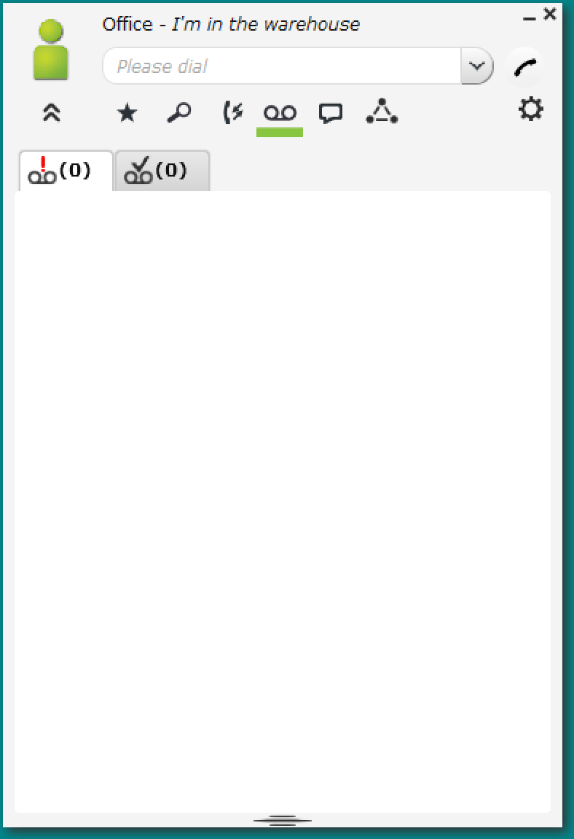
myPortal Smart
Voicemail
Overview of voicemail
Settings made here will automatically be transferred to myPortal to go and the same applies to settings made in myPortal to go.
Notes:
Click for next picture with explanation.

Slide 12
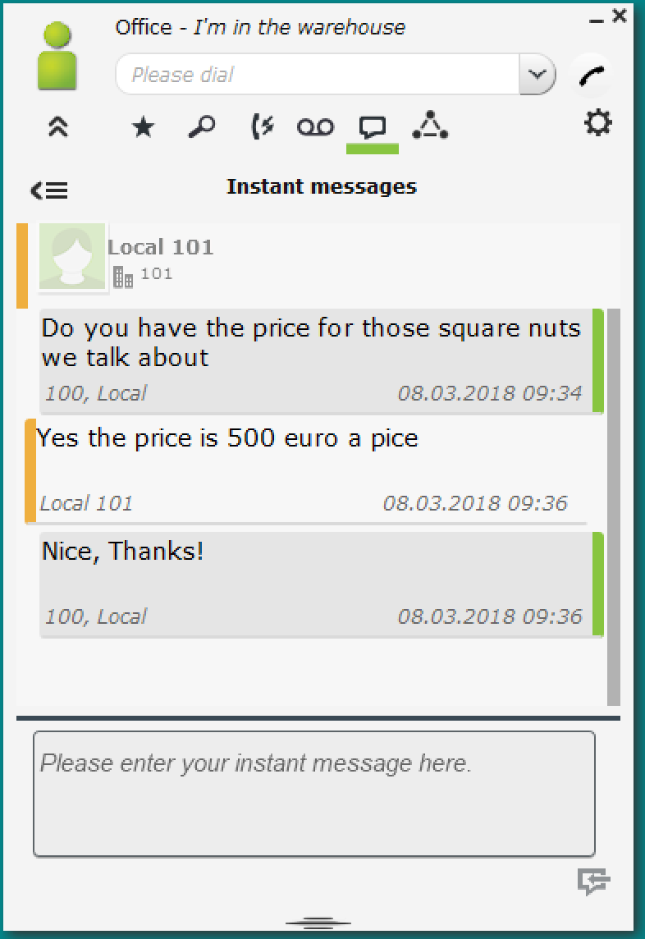
myPortal Smart
Instant messages
Here you can "chat" together, ideal for phone messages, even when on the “Road”
Settings made here will automatically be transferred to myPortal to go and the same applies to settings made in myPortal to go.
Notes:
Click for next picture with explanation.

Slide 13
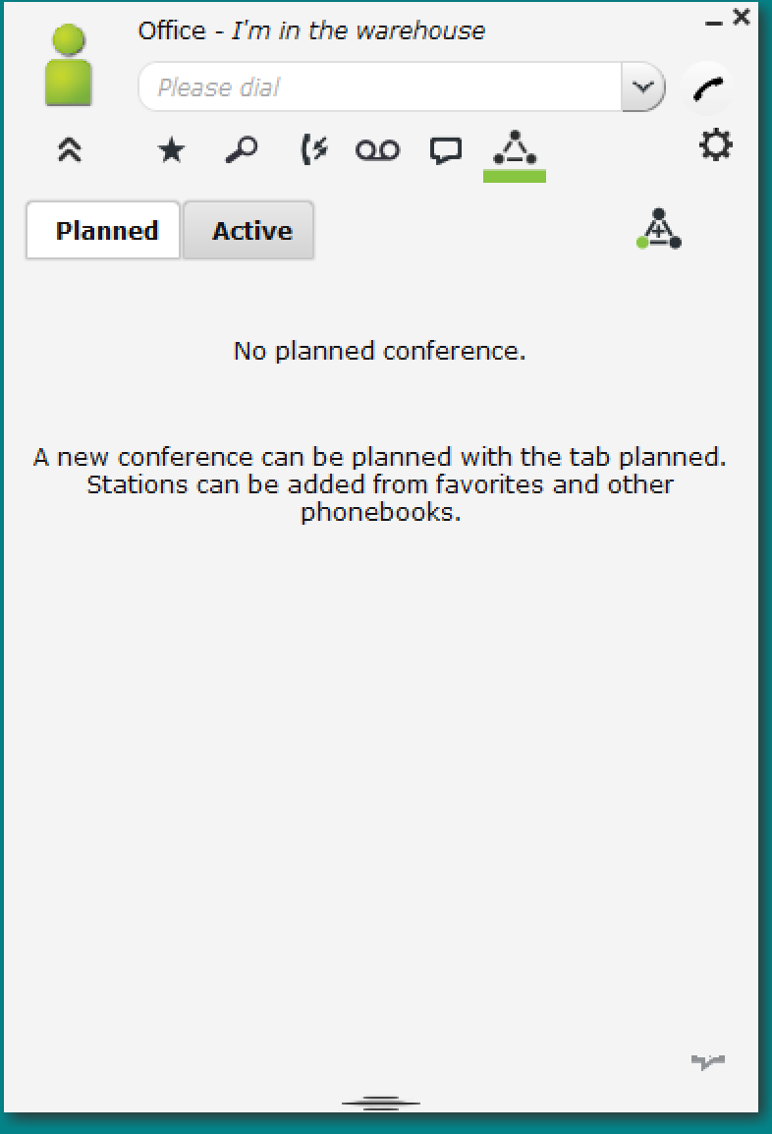
myPortal Smart
Conference
myPortal Smart conference requires license per user, see options
Settings made here will automatically be transferred to myPortal to go and the same applies to settings made in myPortal to go.
Notes:
Click for next picture with explanation.

Slide 14
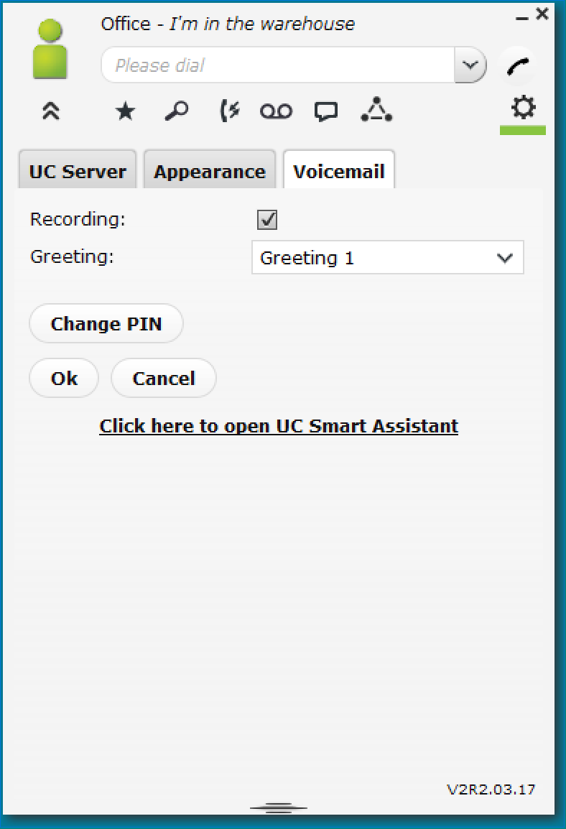
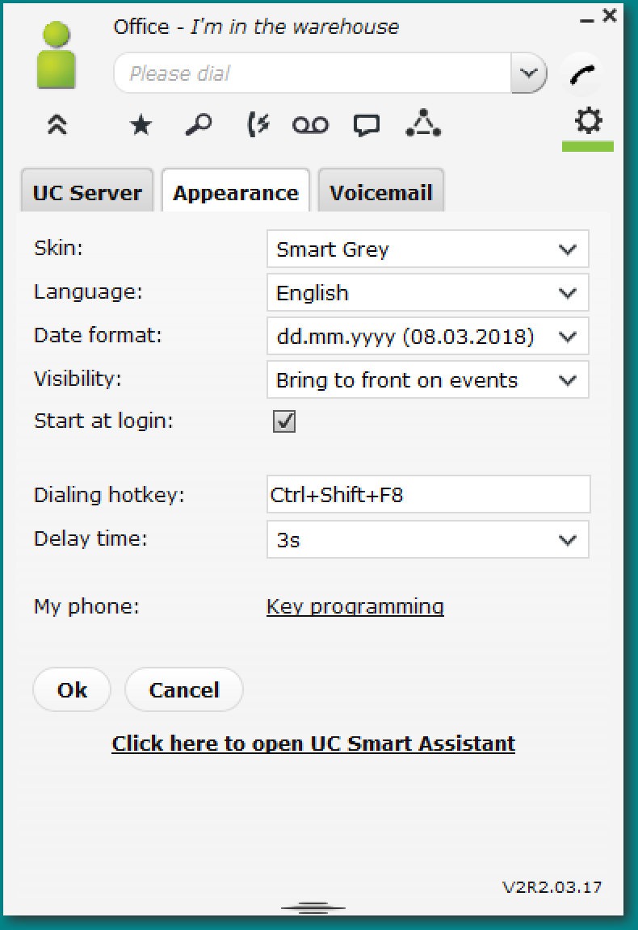
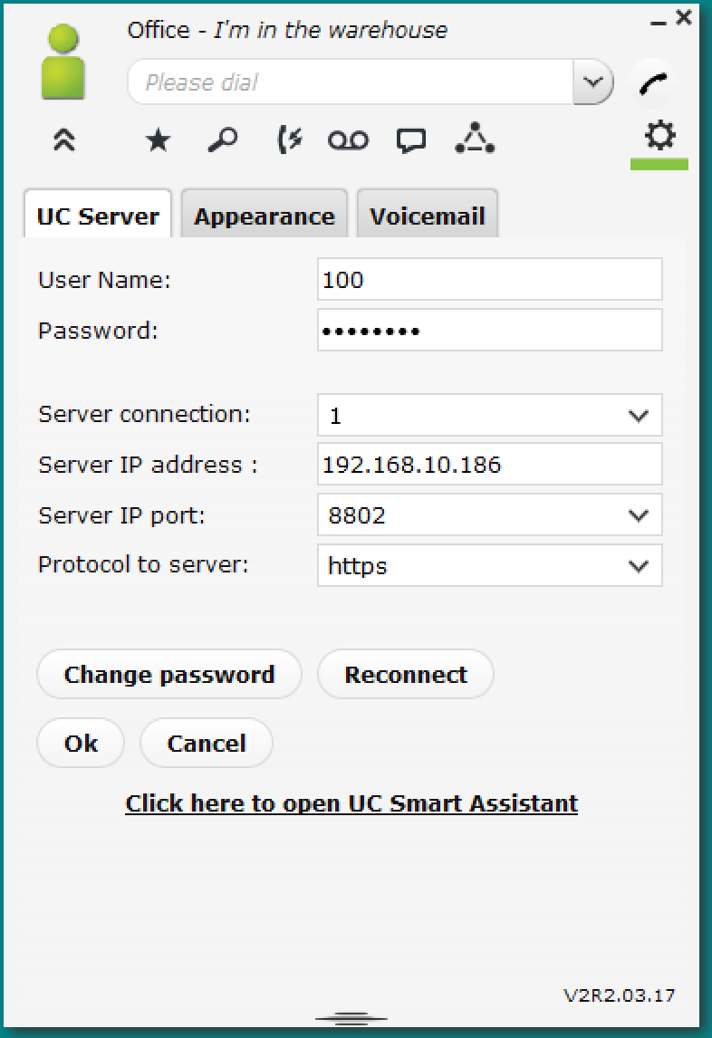
myPortal Smart
UC-Server
Setting up the connection to OSBiz
Apperarance
How should myPortal smart be presented on my screen
Voicemail
Setting up voicemail and absence messages
Settings made here will automatically be transferred to myPortal to go and the same applies to settings made in myPortal to go.
Notes:
Click for next picture with explanation.

Slide 15
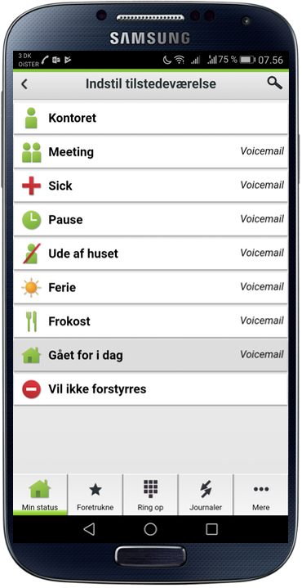
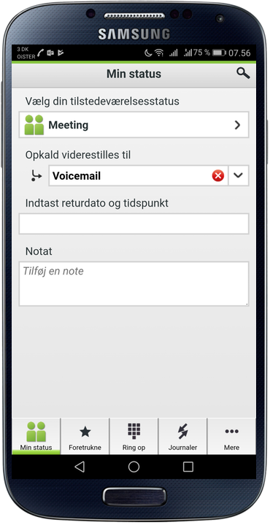
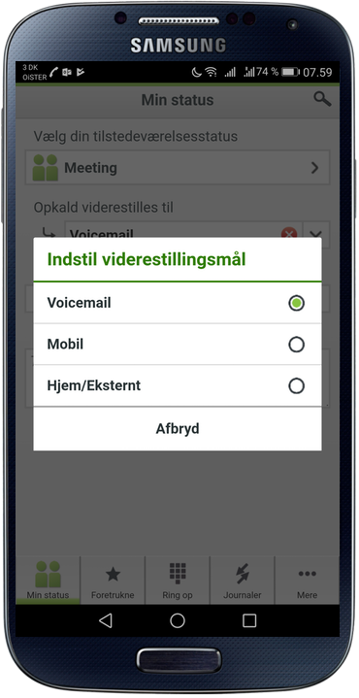
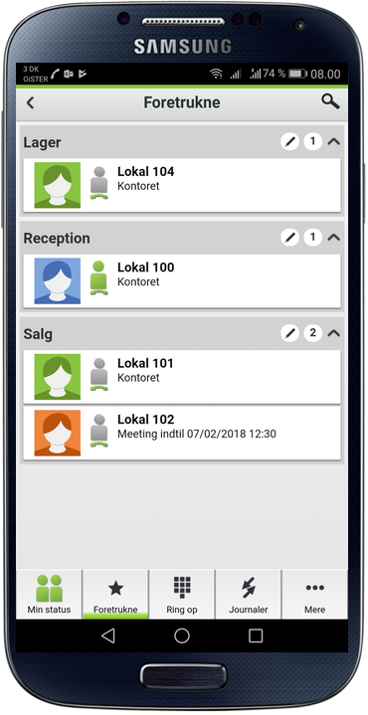
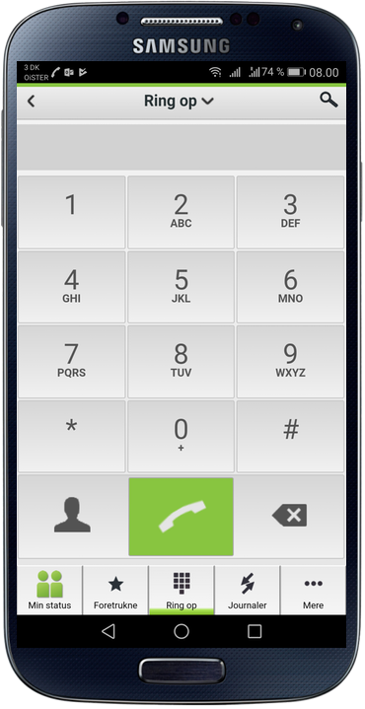
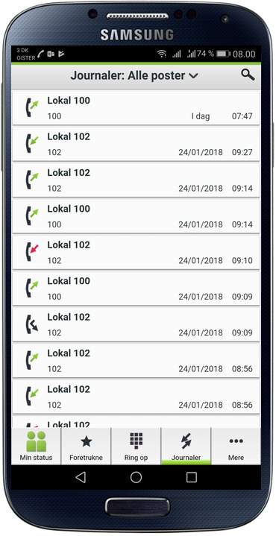
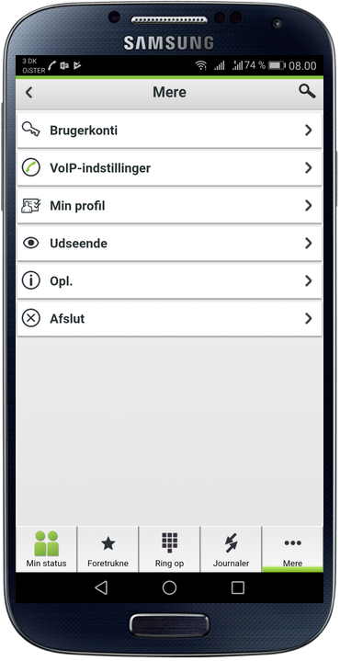
myPortal to go
Key features are the same as for myPortal smart, you can use their smartphone as a device, you can also use Bring Your Own Device (BYOD), One Number Service (ONS), run on internal WIFI and external WIFI or via Mobility The function with halfback when on the go
Notes:
A presentation of myPortal to go, tell about the features make clear the are almost the same as myPortal smart

Slide 16
myPortal to go WIFI and Mobility (ONS)
There are 5 myPortal to go clients included, the use of these is intended for One Number Service (ONS), where two of these are tied to the included IP phones.
ONS can be used on local WIFI, home WIFI and signaling via the 4G / LTE network and voice through GSM (VoIP over LTE are planned)
102/+4512345678 mobilty ONS
102/+4512345678 Company WIFI VoIP
102/+4512345678 Home WIFI VoIP
ITSP
Internet
Calls to a Smartphone with ONS are done by calling their direct number, so your customer does not need to know a mobile number and you have the option to change your presence status so the caller can enter a voicemail, reach the front desk or a colleague
Notes:
A brief explanation of ONS
Requires custom setup in Firewall / Router

Slide 17
Automatic and Manual autoAttendant
Day
Night
Greeting
Greeting
Press 1
Sales
No Reply
Automatic Day / Night
Manual Day / Night
Public holiday
Variable closing times
Queue
Press 1
Guard
Press 2
Warehouse
Busy
Press 2
Open hours
Press 3
Boss
No Reply
Press 3
Press 4
ONS user
Answered
Press 4
Press 5
ONS user
Answered
Press 5
Press 6
ONS user
Meeting
Voicemail
Press 6
Press 7
ONS user
Vacation
Press 7
Press 8
To CP200
Busy
Voicemail
Press 8
Press 9
To CP400
Answered
Press 9
Intercept
Reception
Intercept
Replay
Notes:
A presentation Automatic and Manual autoAttendant

Slide 18

device@home
You can purchase device @ home so you have a working phone at home, it requires an OpenScape Desk Phone CP that can run on your existing internet connection.
103/+4587654321 Company
103/+4587654321 Home
ITSP
Internet
Notes:
A brief explanation of device @ home, remember to tell you to make rules in the firewall

Slide 19
Internet Telephony Service Provider (ITSP) and Session Initiation Protocol (SIP)
ITSP (SIP) must be considered as the default ISDN substitute - ITSP (SIP) is generally cheaper than ISDN
Read more about ITSP and SIP here:
In Denmark there are four providers approved by Unify, they can be found here:
In Sweden there are two providers approved by Unify, they can be found here:
In Norway there are none providers approved by Unify.
In Finland there are two providers approved by Unify, they can be found here:
Number series by ITSP is not included in the offer and must be ordered separately.
There are also alternative providers but troubleshooting / support may be billed
ITSP
SIP
ITSP Providers
ITSP Providers
ITSP Providers
Notes:
Here you can insert a Presentation of the SIP providers you as a partner prefer.
Remember, however, they must be approved for Unify support.
Link for Sweden: http://wiki.unify.com/wiki/Collaboration_with_VoIP_Providers#Sweden
Link for Finland: http://wiki.unify.com/wiki/Collaboration_with_VoIP_Providers#Finland
Link for Norway: None

Slide 20
Hostingcenter
Hosted
Home
Company
ITSP
Internet
On-premesis
Company
Home
ITSP
Internet
Notes:
Here you can explain the difference between hosted and on premsis. You can also delete this if you do not want to offer one or the other.
Whether the customer wants hosted or on-premesis there will always be a purchase.
If you as a partner want to offer it as a Pay Per User and hosted the solution to yourself, this is of course also possible.
Text 2 - Purchase or rent of telecommunications / communication facilities (Investment or Operating budget)

Slide 21

Windows
Cloud
Announcement
Precense
Mac OS
On-Premise
Auto Attendant
Voice2Email
VMWare
Mobilitet
Automatic Day/Night
Fax
Hyper V
ITSP
Conference
Click to Dial
Skype for Business interworking
TLS V1.2
One Number
Call Journal
Circuit
SIP
Visual Voicemail
Hybrid
BYOD
device@home
Notes:
Input if you want to explain more about OSBiz, such as extended features UC Suite, Call Center and more

Slide 22
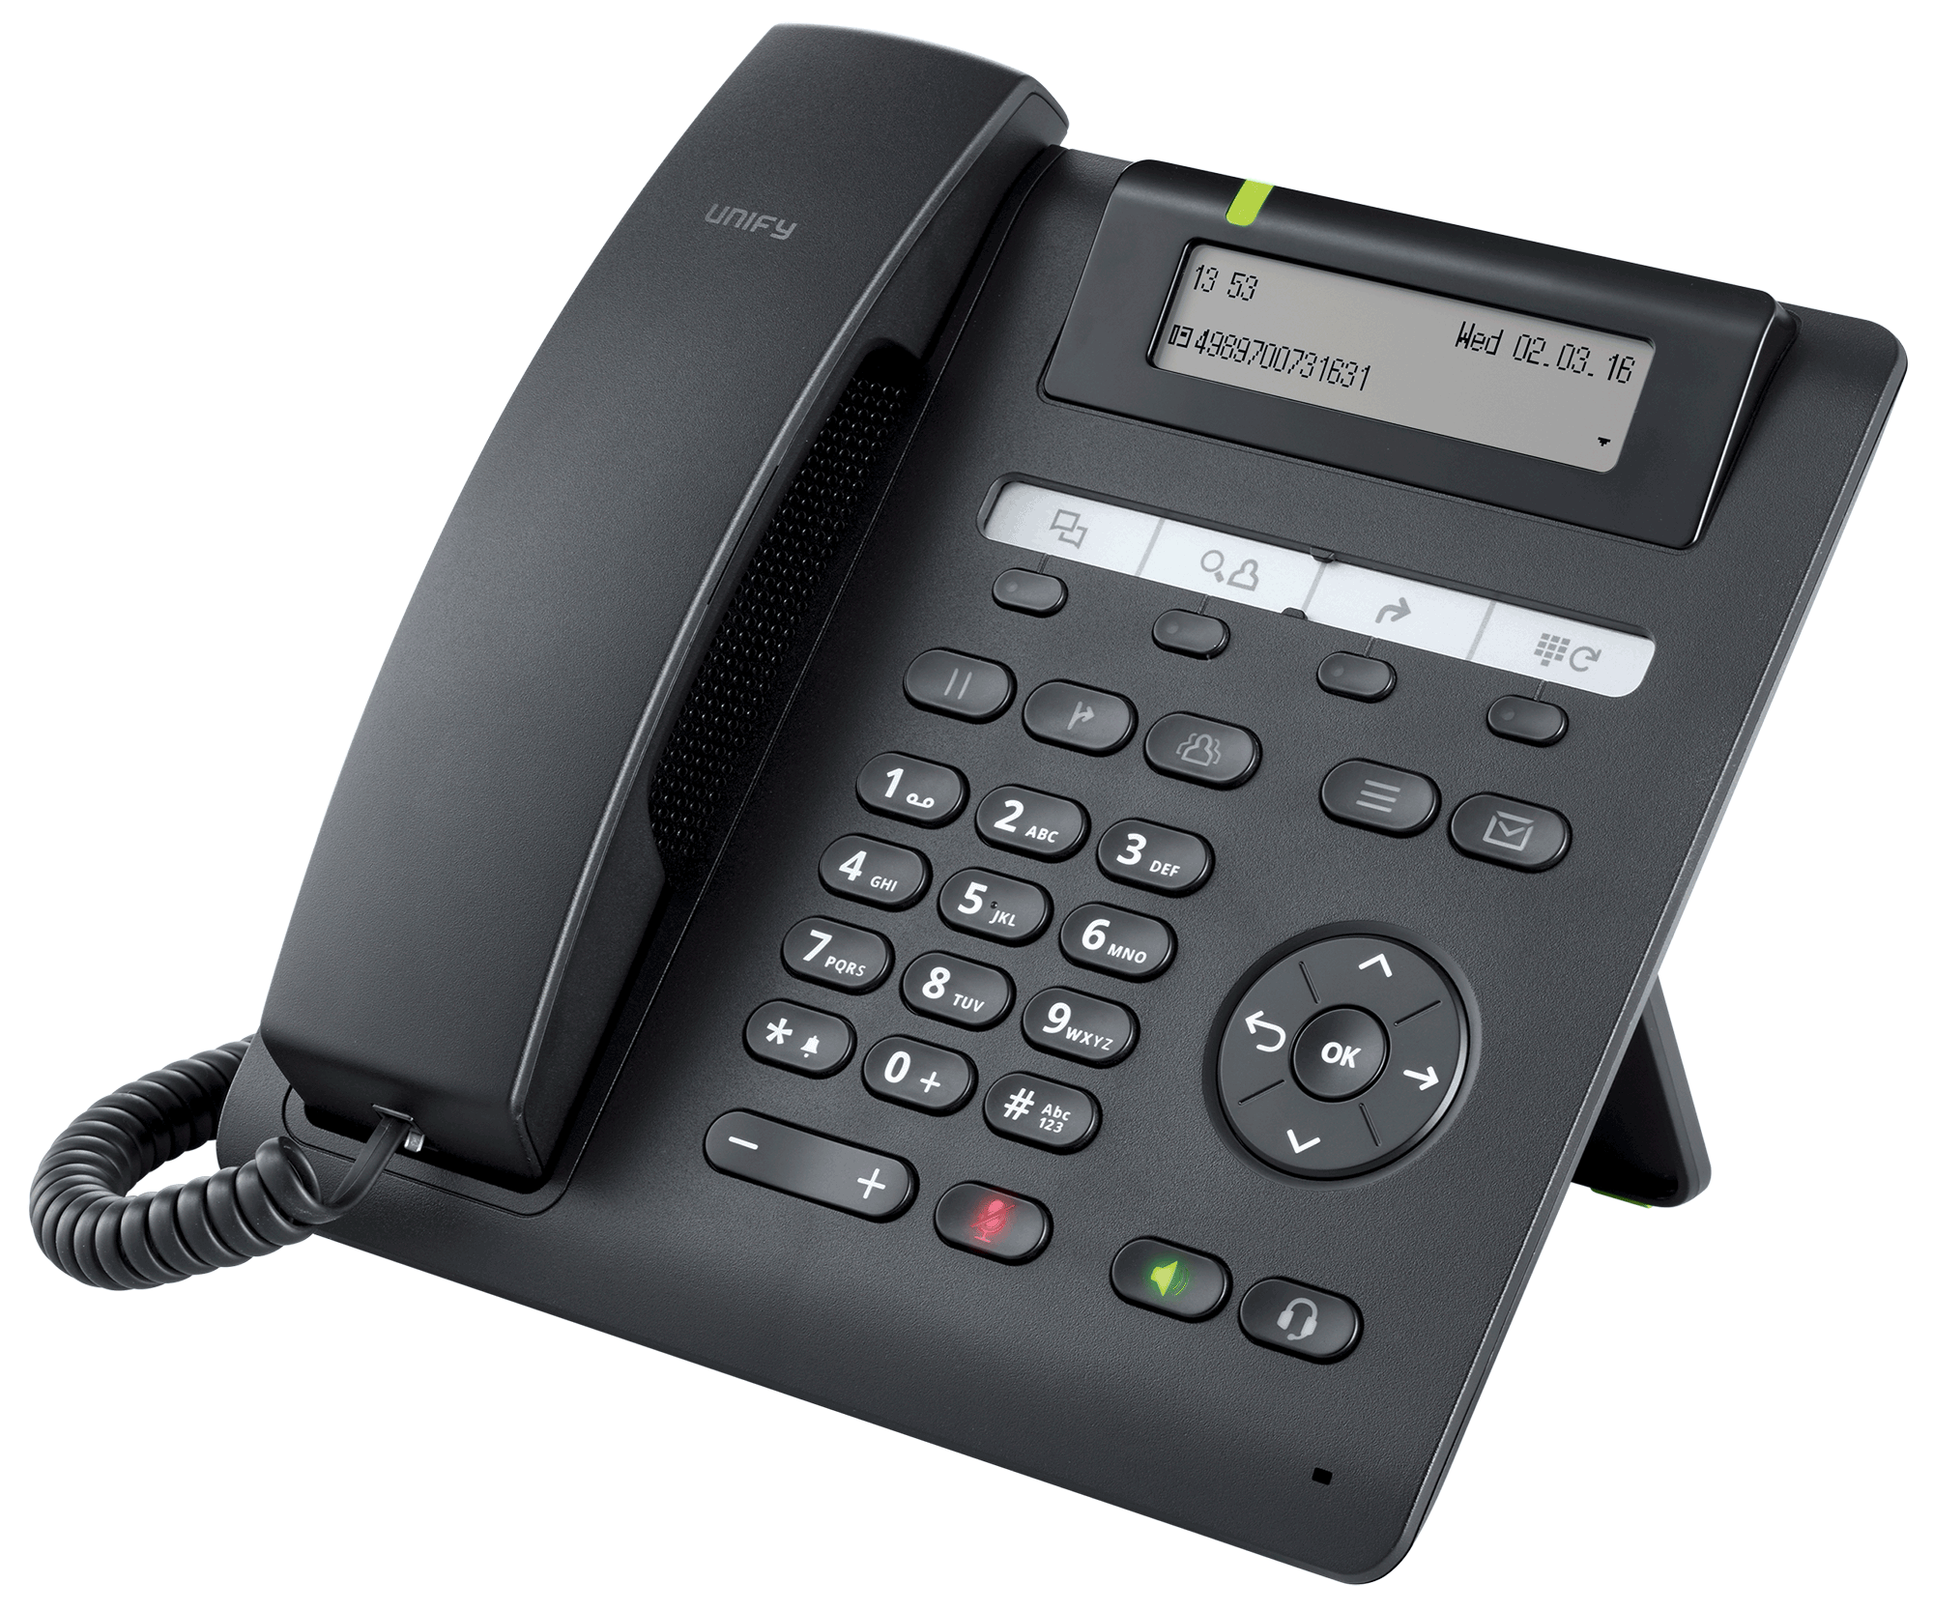
Included: 1 stk. OpenScape Business S System DVD
1 stk. Suse Linux Enterprise Server 11 SP4 DVD
1 stk. OpenStage Desk Phone CP 200
1 stk. OpenStage Desk Phone CP 400
5 stk. Licenses for OpenStage CP HFA/SIP phones
8 stk. Licenses for ITSP
5 stk. Licenses for myPortal Smart
5 stk. Licenses for Voicemail
1 stk. License for Auto Attendant
Notes:
What is included in the offer when you have bothered the license, please send it to ALSO as we ensure that the license has not been split up.
The requirements made for you as a partner:
Required: Sales Training Course / Certification
Basic installation course 1 or 2 days at ALSO in Denmark
OVA Installation in the VMWare environment ½ day

Slide 23
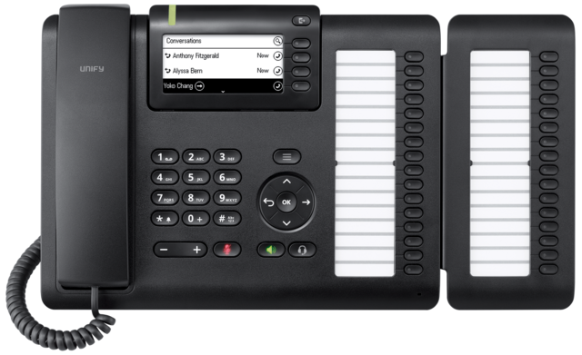
Phone Optioner: 1 stk. OpenScape Desk Phone CP 200 inklusiv licens og myPortal Smart
1 stk. OpenScape Desk Phone CP 205 inklusiv licens og myPortal Smart
1 stk. OpenScape Desk Phone CP 400 inklusiv licens og myPortal Smart
1 stk. OpenScape Desk Phone CP 600 inklusiv licens og myPortal Smart
1 stk. OpenScape Desk Phone CP 400 Key Module - KM 400
1 stk. OpenScape Desk Phone CP 600 Key Module - KM 600
myPortal to go option: 1 stk. myPortal to go licens
Virtuel FAX: 1 stk. Software Fax
Conference: 1 stk. Conference per user
ITSP lines: 1 stk. Trunk licens (ITSP must also open for one channel per license)
CP400 With keymodul
Notes:
The options are for the purchase of phones, licenses, and more

Slide 24







Headet Optioner:
Jabra
Plantronics
Server Optioner:
2840343 870210-421 HPE ProLiant MicroServer Gen10 X3421 16 GB-U 4LFF Non Hot-Plug SATA No HDD 1x 200W PSU
2983730 P03706-425 HPE ProLiant ML30 Gen9 E3-1230v6 3.5GHz 4C, 8GB, B140i, 4LFF Hot Plug SATA, No HDD, DVD-RW, 2x 1Gb NIC, 1x 460W Red PSU
2499068 829889-B21 HPE DL20 G9 1U G4400 (3,3GHz 2C) 4GB 2133U SR ohne HDD (max. 2x nhp 3.5Zoll) B140i 2x1Gb Nic 290W nhp 1J-VOS (DE)
2667702 861691-B21 HPE 1TB SATA 6G Midline 7.2K LFF (3.5in) SC 1yr Wty HDD
2840021 VFY:T1333SX120NC FUJITSU PY TX1330 M3 SFF XEON E3-1220V6 16GB DDR4-2400 BASIC 2.5inch KIT 8X
2840022 VFY:R1333SX110NC FUJITSU PY RX1330 M3 SFF XEON E3-1220V6 16GB DDR4-2400 HOT PLUG PSU RED FANS
2426024 S26361-F3907-L100 FUJITSU HDD SATA 6Gb/s 1TB 7200rpm 512e hot-plug 2.5inch business critical
2821418 S26361-F3909-L616 FUJITSU 16GB RAM 1x16GB 2Rx8 Modul DDR4 unbufferend ECC 2400MHz DIMM
2820279 VFY:T1313SC010IN FUJITSU PRIMERGY TX1310 M3 Xeon E3-1225V6 1x8GB 2x 1TB HDD 3.5inch DVD-RW SM
2555344 S26361-F3952-L100 FUJITSU HD SATA 6Gb/s 1TB 7200rpm 512e non hot-plug 3.5inch economic
2821417 S26361-F3909-L615 FUJITSU 8GB RAM 1x8GB Modul DDR4 unbufferend ECC 2400MHz DIMM
Netværks Optioner:
2171238 GS110TP-200EUS NETGEAR 8 Port Gigabit Smart Switch with PoE - 2 Gigabit Fiber Ports - Desktop – fanless
2912337 JL258AR HPE Aruba 2930F 8G PoE+ 2SFP+ Switch Renew
2597477 02354037 HUAWEI S5700-10P-PWR-LI-AC 8 Ethernet 10/100/1000 PoE+ ports,2 Gig SFP,AC 110/220V
Firewall Optioner:
Sophous Security
Endpoint Protection Optioner:
Kaspersky

Slide 25
Authorized OpenScape Business
Notes:
Here you will present your own company, who you are and how to get in touch with you

